Slide 1

Easier Posts & Sharing?
Jobs Posting & Sharing Idea

Slide 2
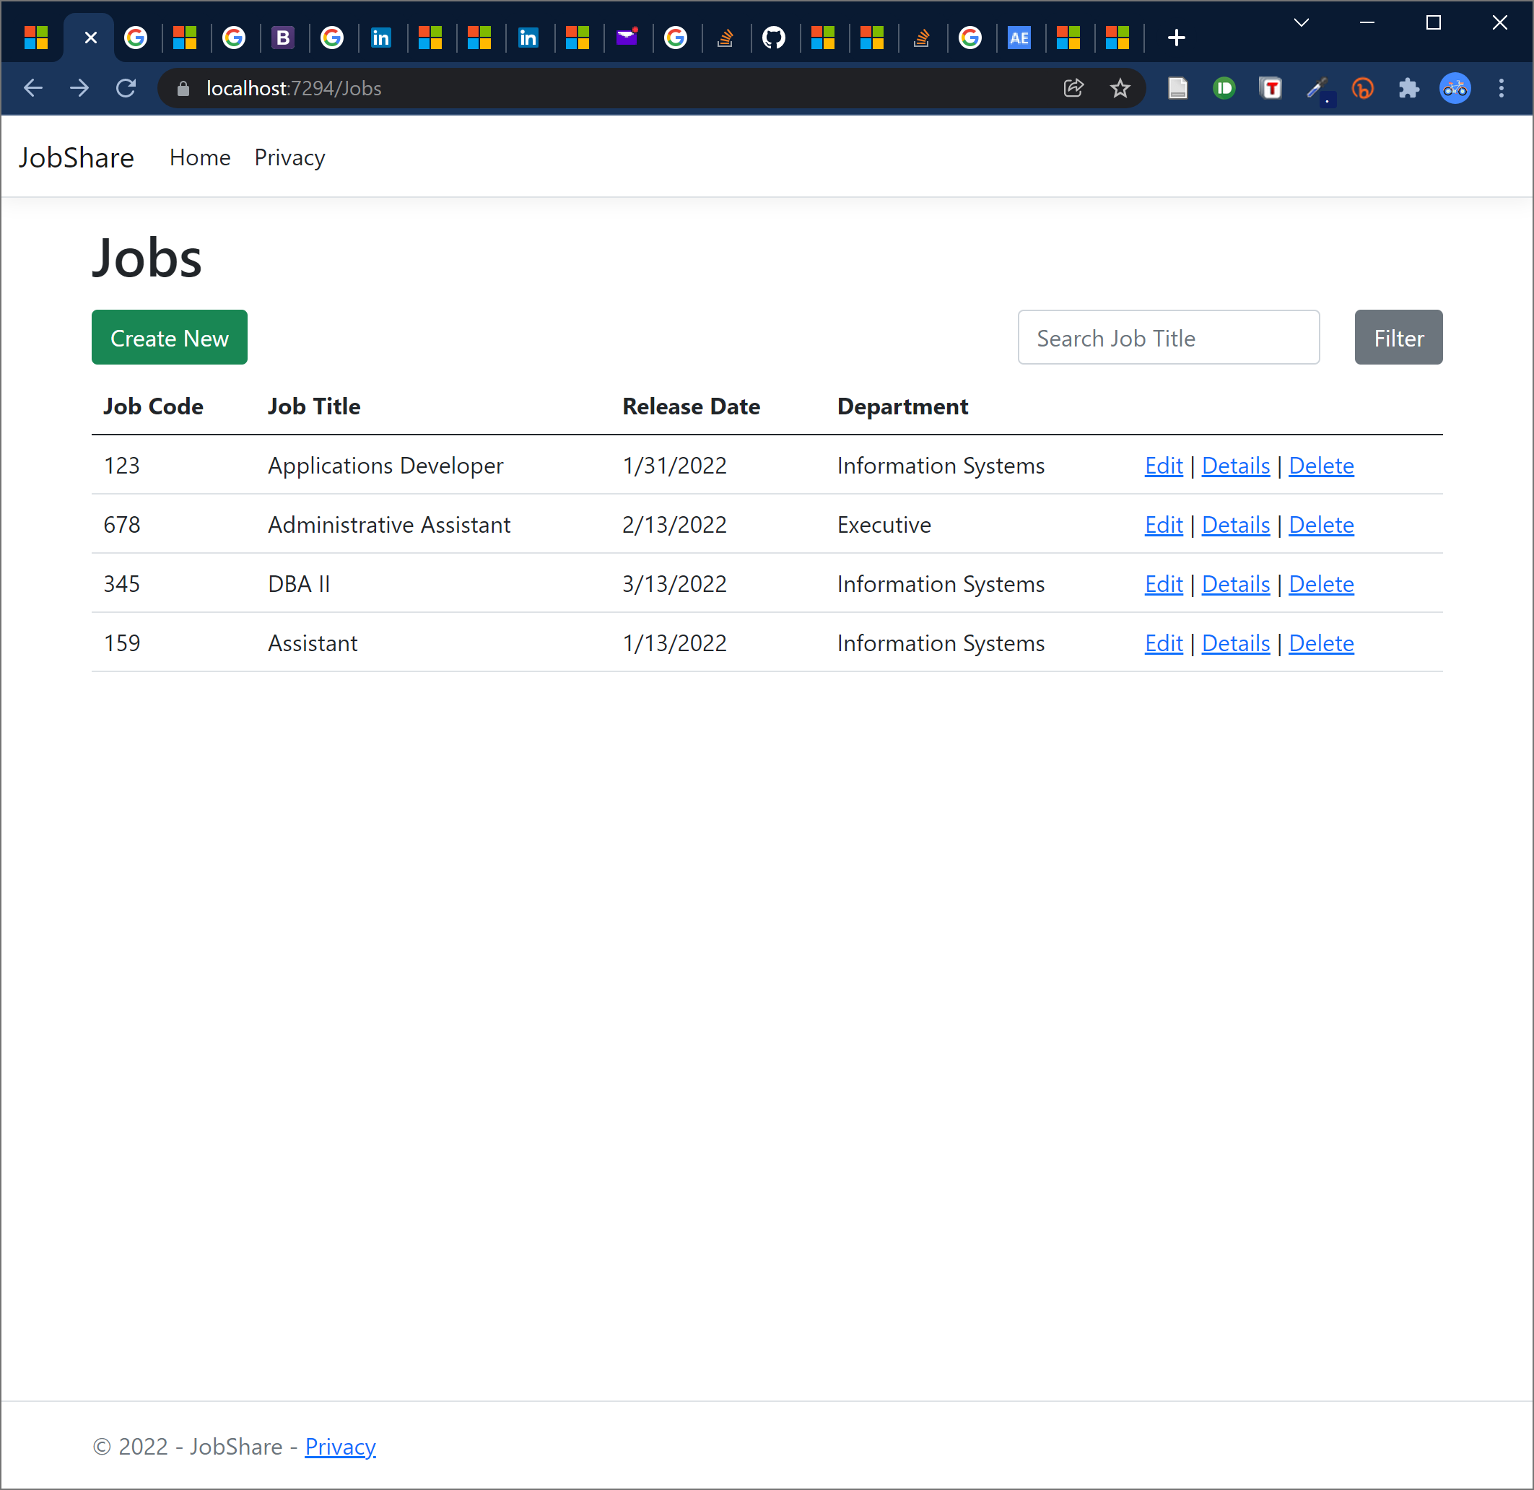
Jobs Board

Slide 3
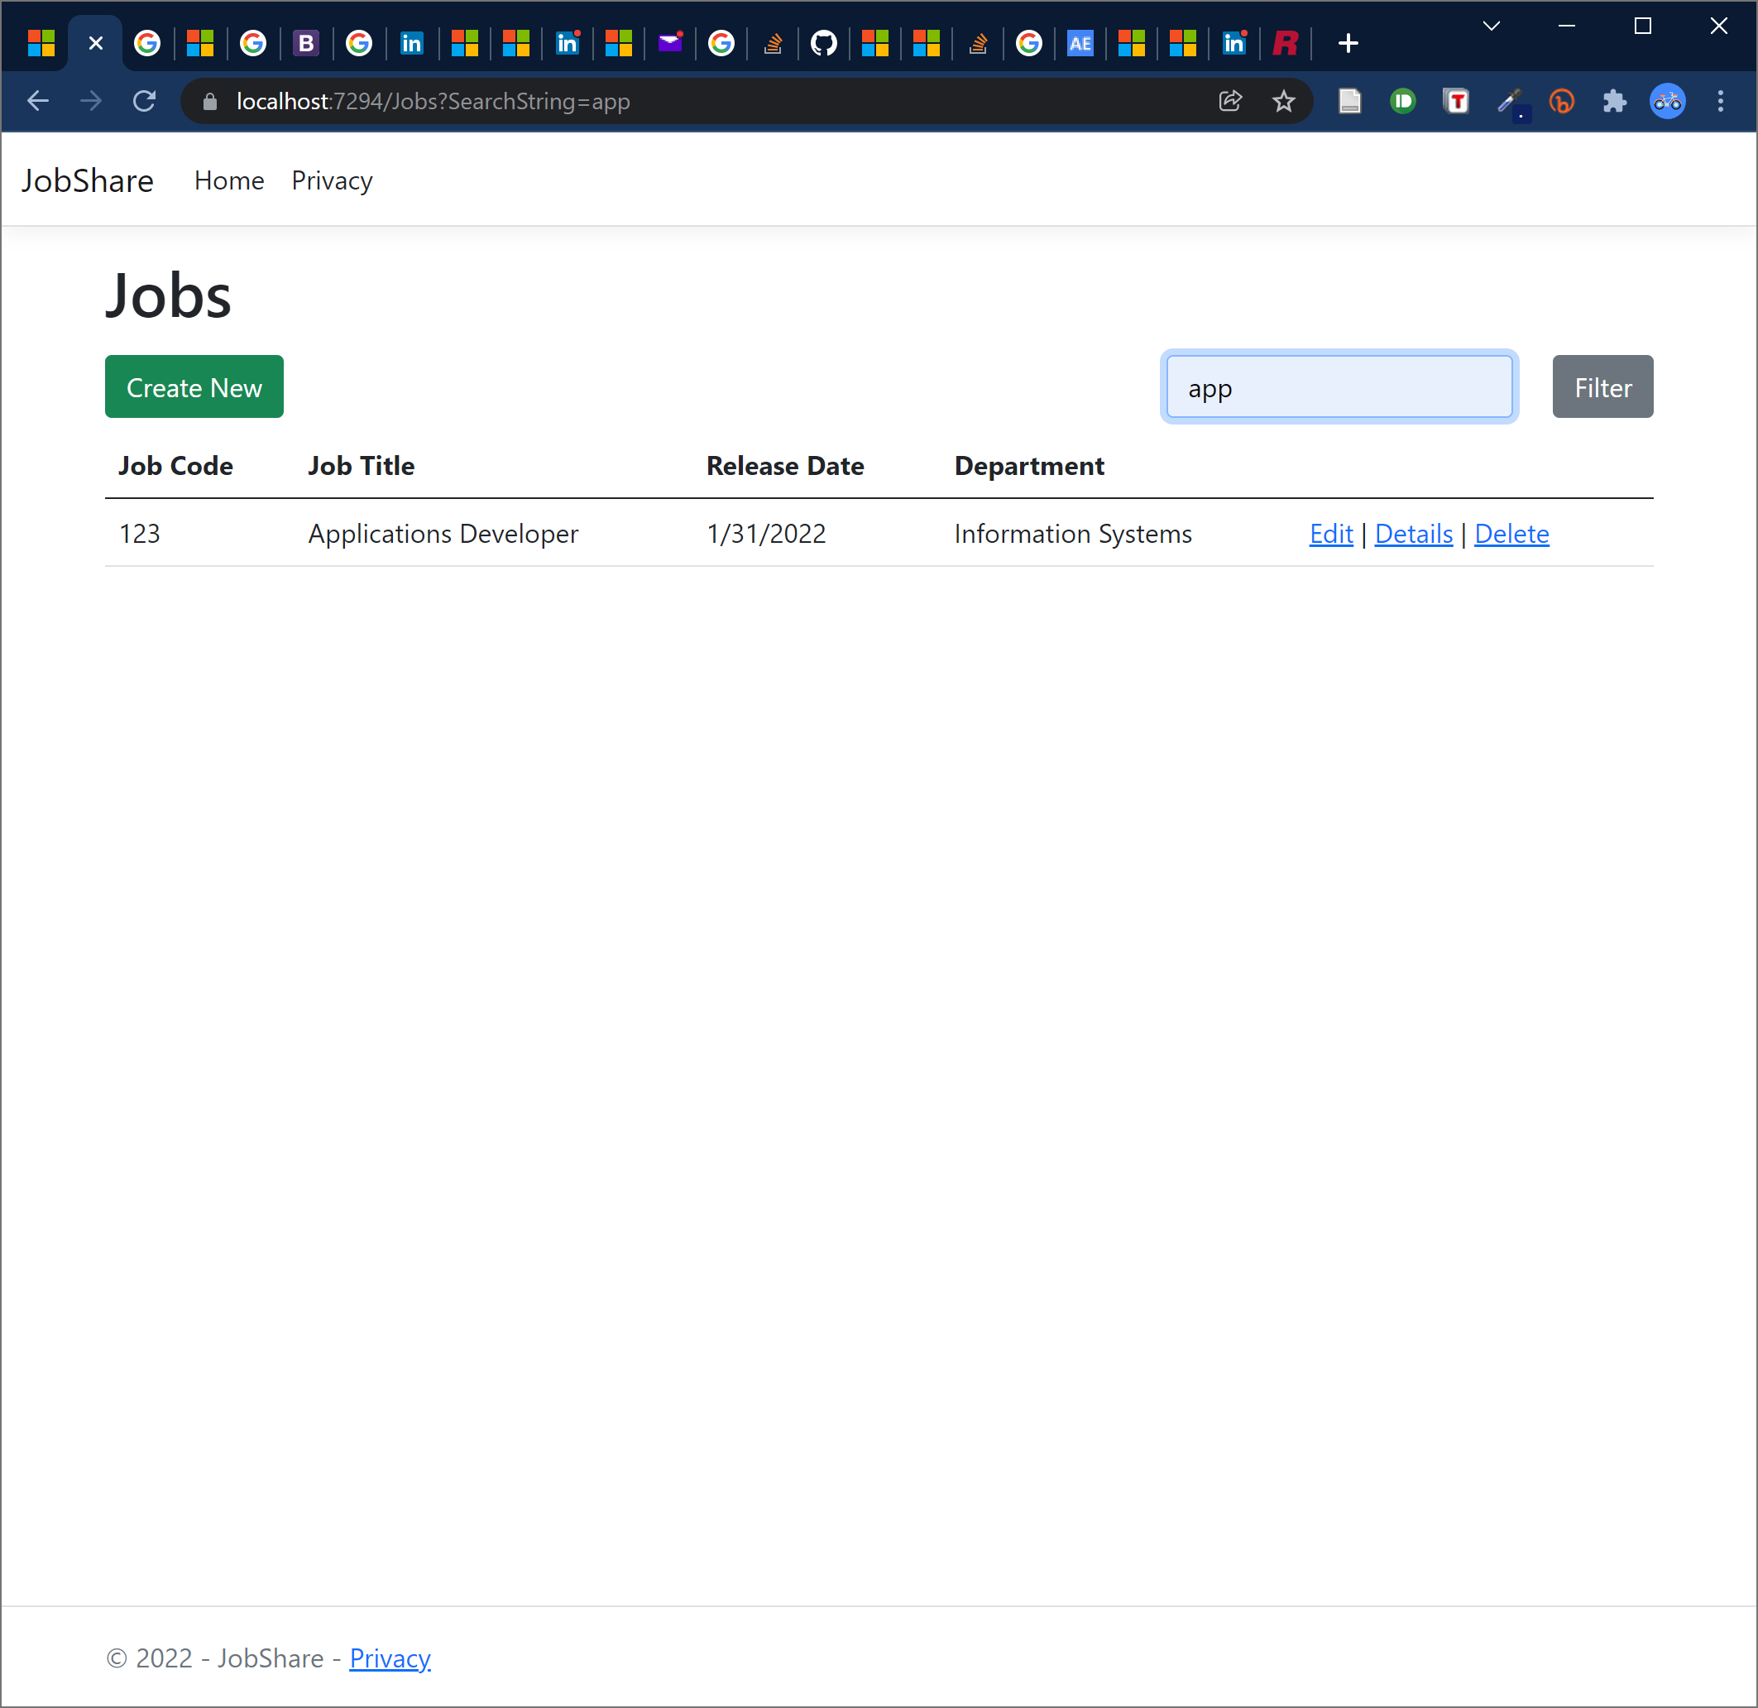
Searchable, Filterable

Slide 4
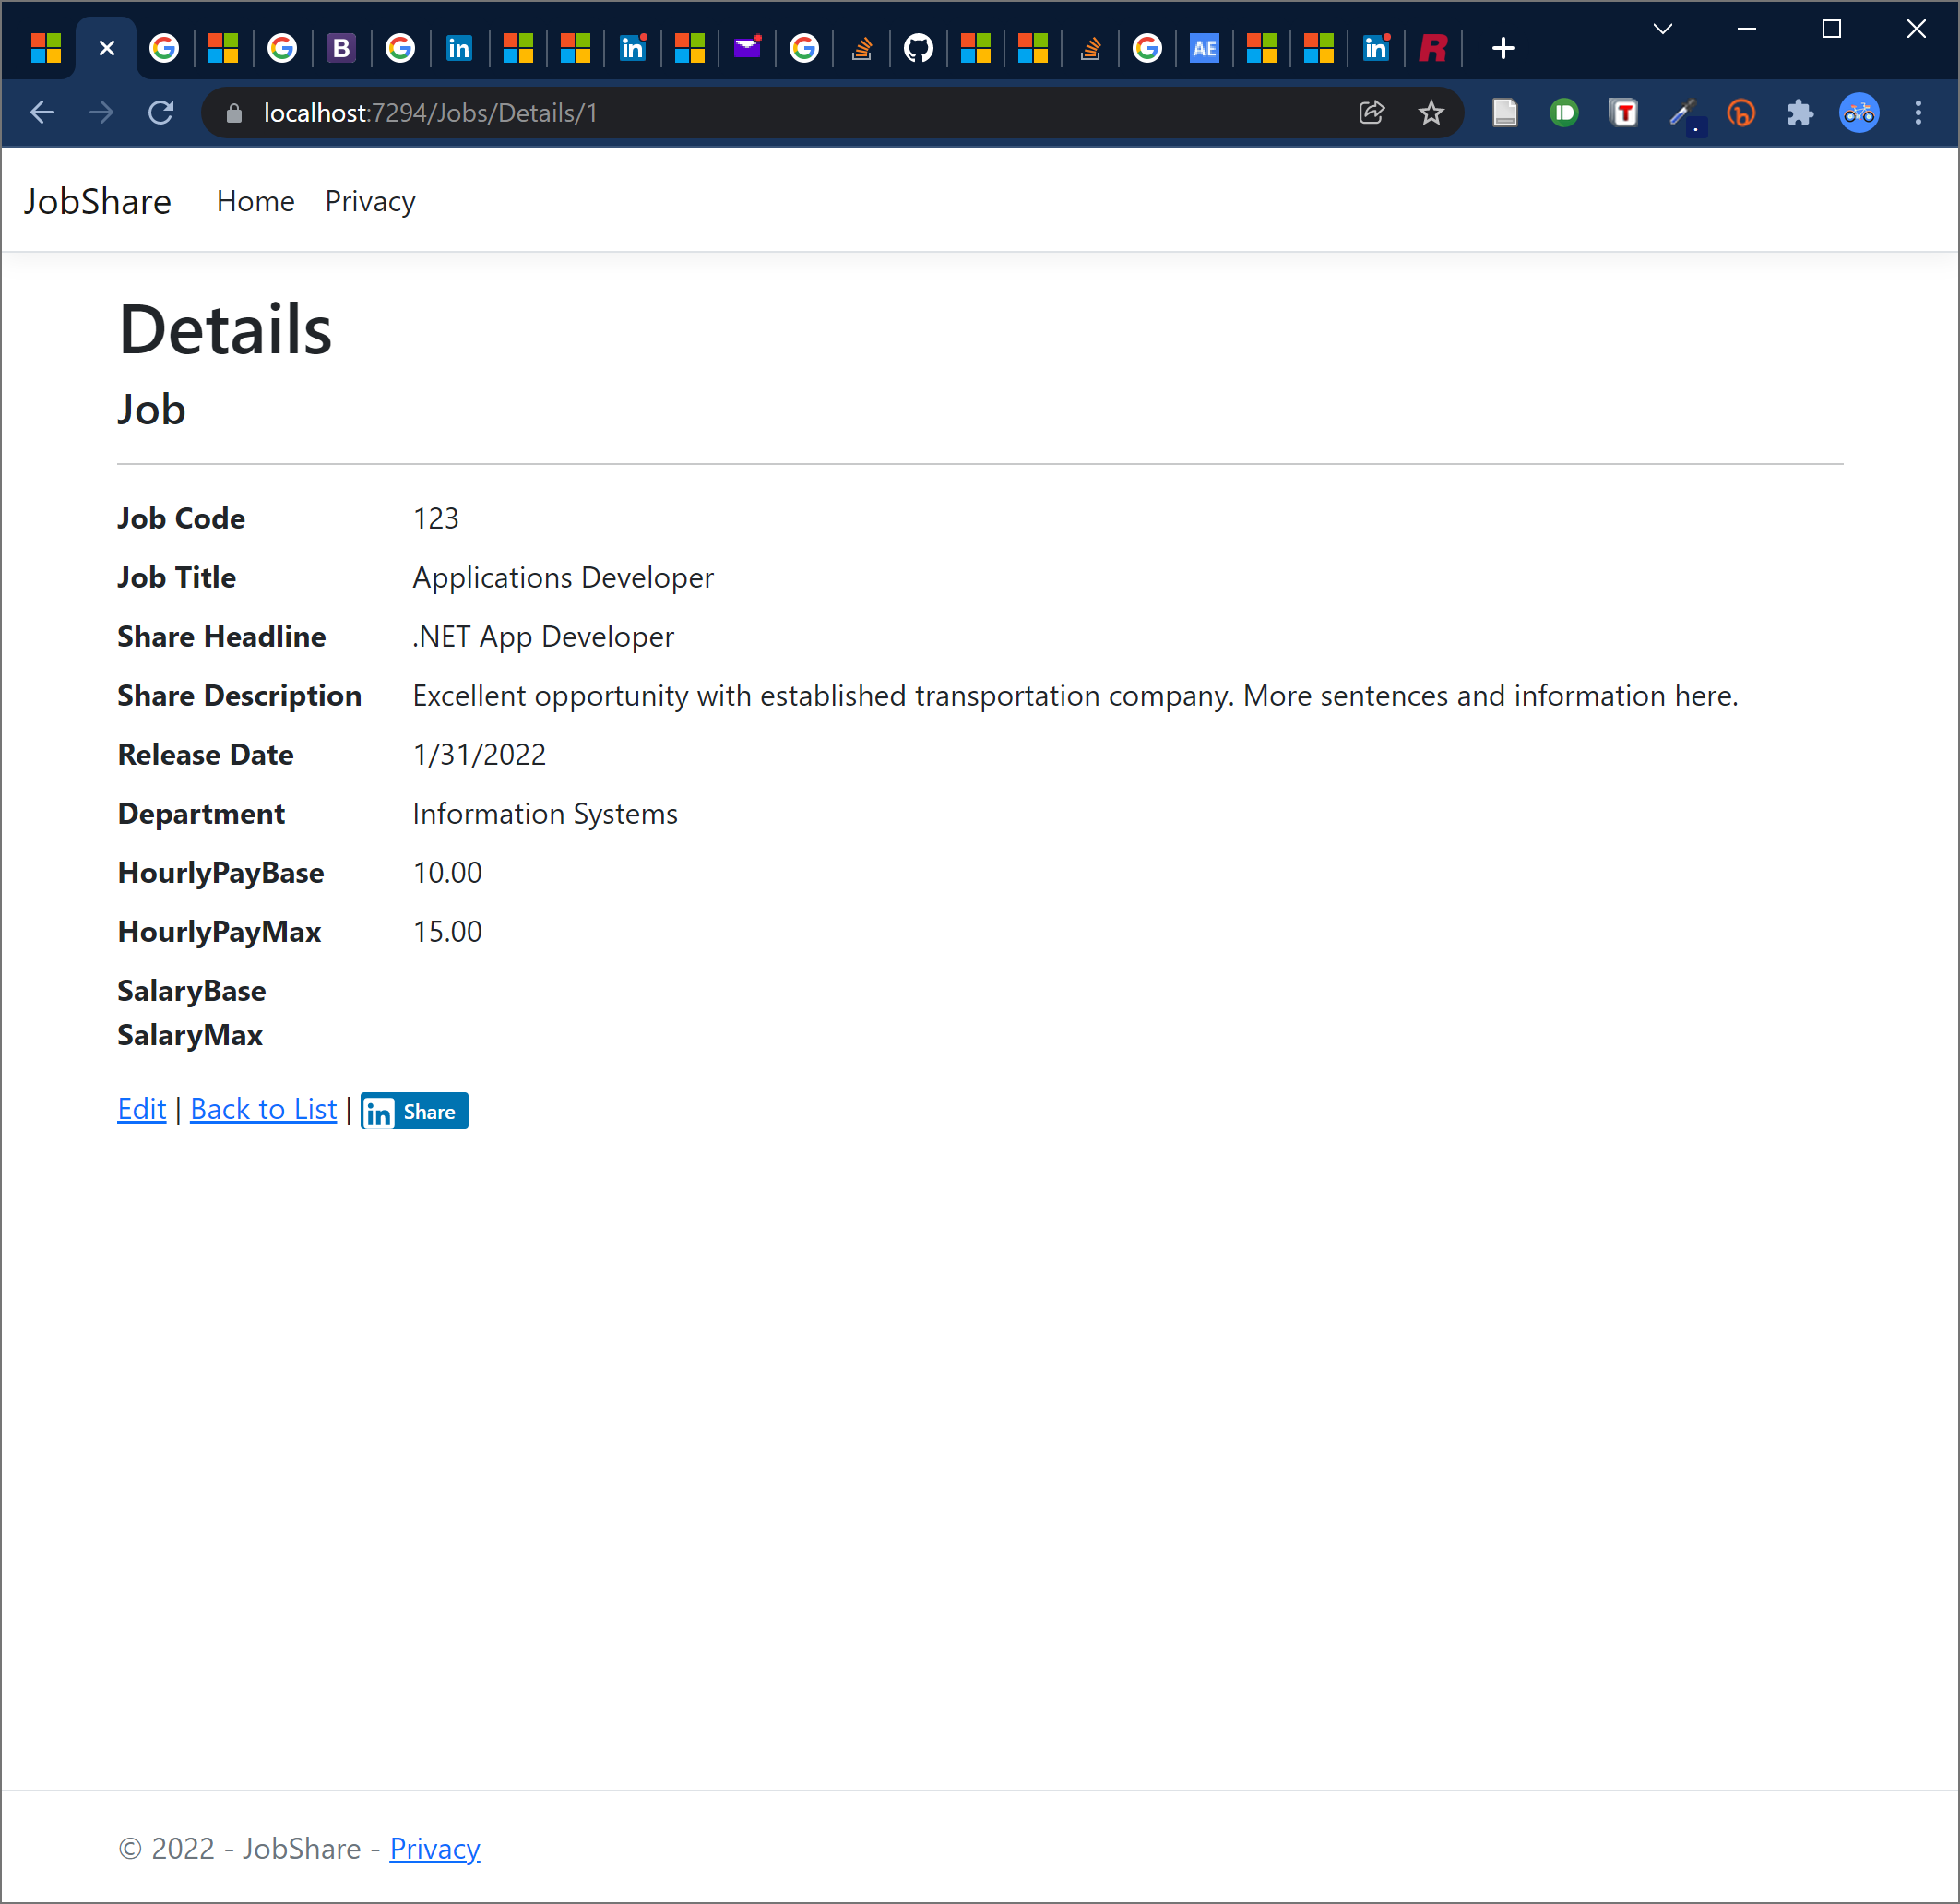
Drill Down to Details

Slide 5
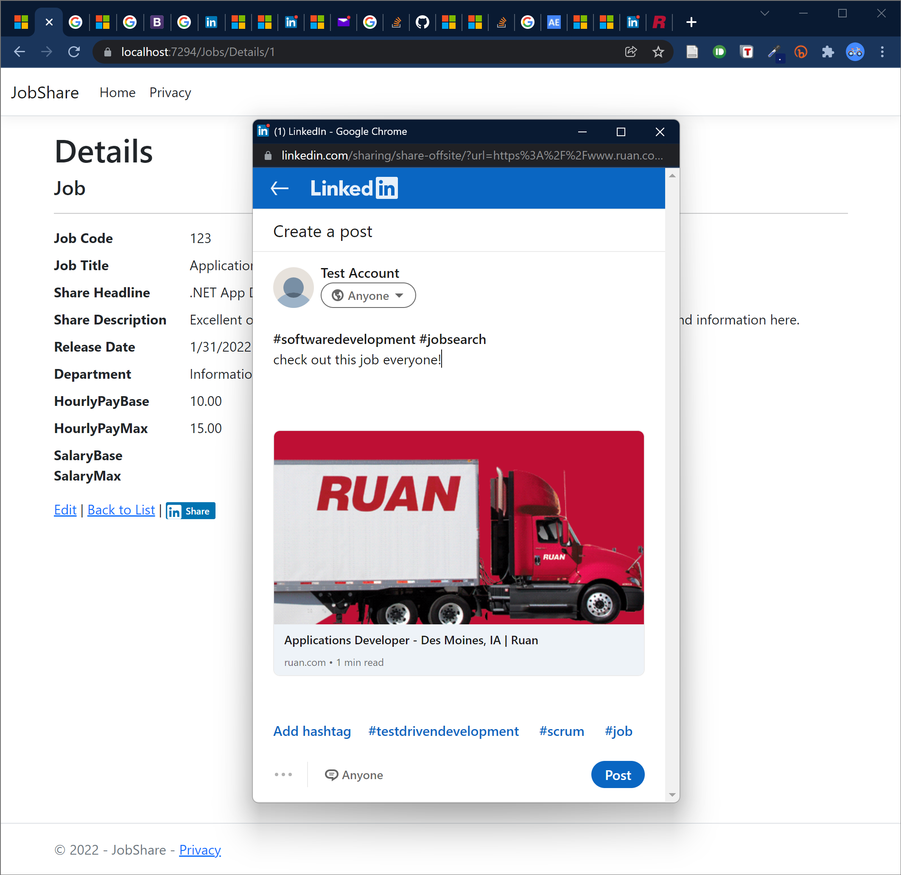
Share via Social Button

Slide 6
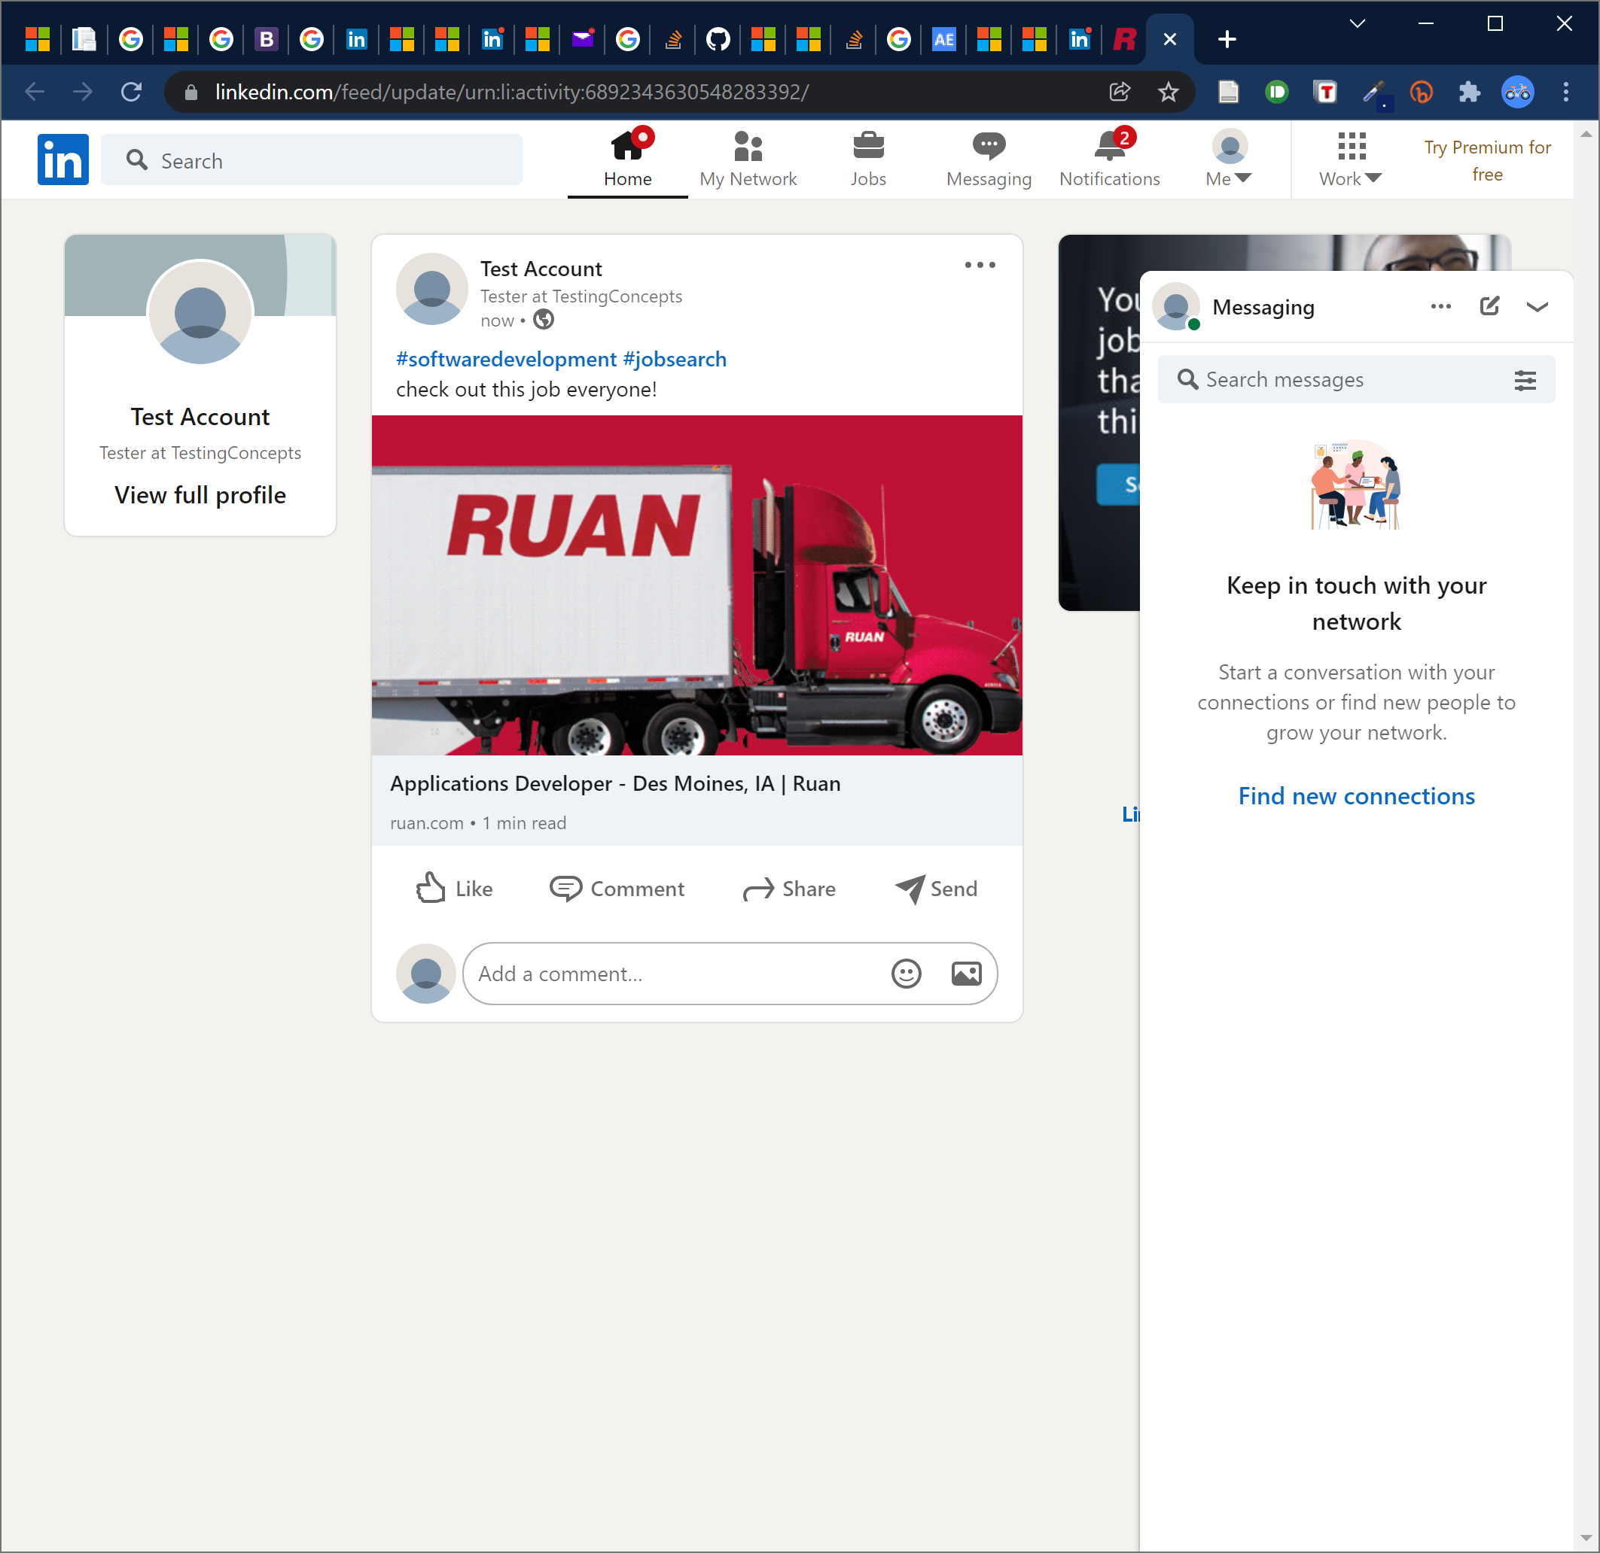
Pre-format for Easy Sharing & Compelling Content

Slide 7
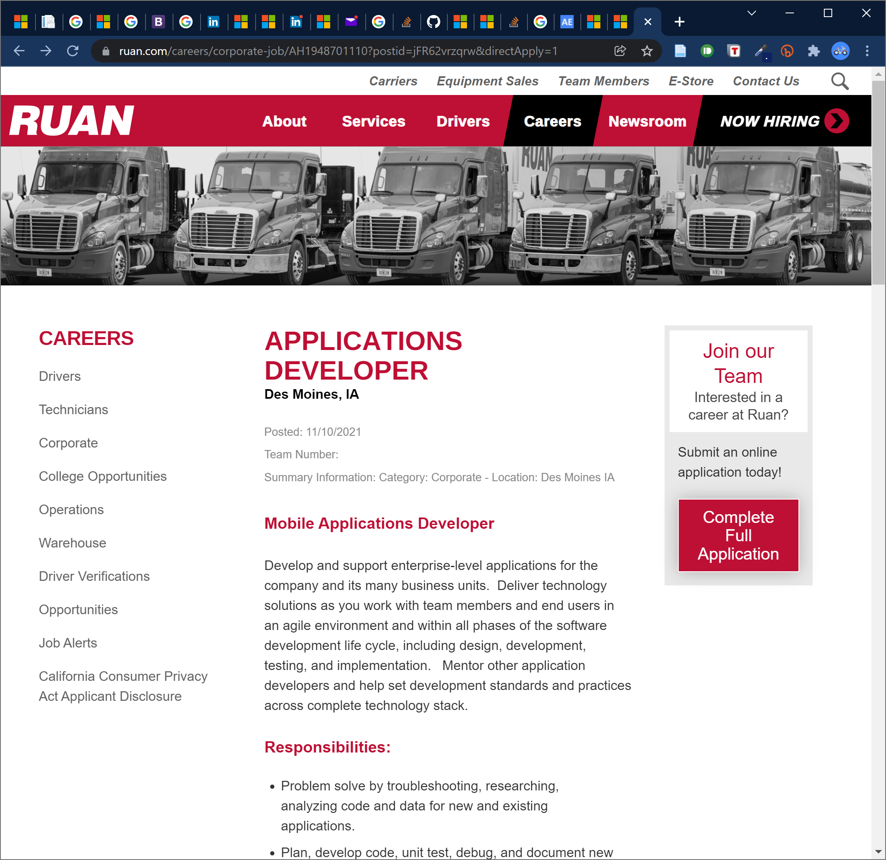
Ruan already has a usable jobs board… but it’s not easy to share the jobs, and we don’t know if the posting process could be improved.
https://www.ruan.com/careers/corporate?st=IA

